Slide 1
Introduction to Research Methodology:

Slide 2
What is Research ?
Research refers to a search for knowledge.
Research is a a scientific and systematic search for pertinent information on a specific topic.
Research is an art of scientific investigation.
Some people consider research as a movement, a movement from the known to the unknown.
It is actually a voyage of discovery.

Slide 3
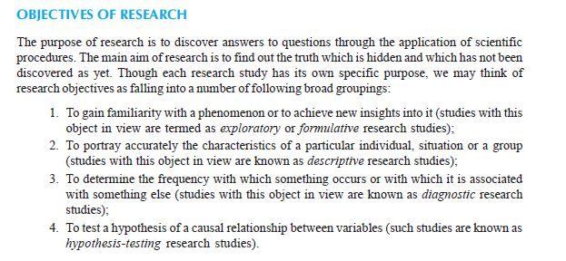

Slide 4
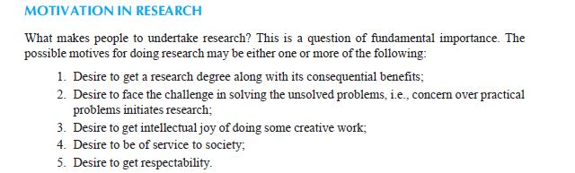

Slide 5
Types of Research
Descriptive vs. Analytical: Descriptive research includes surveys and fact-finding enquiries of different kinds.
The major purpose of descriptive research is description of the state of affairs as it exists at present.
In social science and business research we quite often use this types.
The main characteristic of this method is that the researcher has no control over the variables; he can only report what has happened or what is happening.

Slide 6
Applied vs. Fundamental:
Research can either be applied (or action) research or fundamental (to basic or pure) research.
Applied research aims at finding a solution for an immediate problem facing a society or an industrial/business organisation, whereas fundamental research is mainly concerned with generalisations and with the formulation of a theory.
“Gathering knowledge for knowledge’s sake is termed ‘pure’ or ‘basic’ research.”
Research concerning some natural phenomenon or relating to pure mathematics are examples of fundamental research.

Slide 7
Research to identify
social,
economic
or political trends that may affect a particular institution or the copy research
To find out whether certain communications will be read and understood) or the marketing research or evaluation research are examples of applied research.

Slide 8
Quantitative vs. Qualitative:
Quantitative research is based on the measurement of quantity or amount.
It is applicable to phenomena that can be expressed in terms of quantity.
Qualitative research, on the other hand, is concerned with qualitative phenomenon, i.e.,phenomena relating to or involving quality or kind.
For instance, when we are interested in investigating the reasons for human behaviour (i.e., why people think or do certain things).
we quite often talk of ‘Motivation Research’, an important type of qualitative research.
This type of research aims at discovering the underlying motives and desires, using in depth interviews for the purpose.

Slide 9
Qualitative research is specially important in the behavioural sciences where the aim is to discover the underlying motives of human behaviour.
Through such research we can analyse the various factors which motivate people to behave in a particular manner or which make people like or dislike a particular thing.

Slide 10
Conceptual vs. Empirical:
Conceptual research is that related to some abstract idea(s) or theory.
It is generally used by philosophers and thinkers to develop new concepts or to reinterpret existing ones.
On the other hand, empirical research relies on experience or observation alone, often without due regard for system and theory.
It is data-based research, coming up with conclusions which are capable of being verified by observation or experiment.

Slide 11
Research Approaches
Two basic approaches to research,
Quantitative approach
Qualitative approach.
The former involves the generation of data in quantitative form which can be subjected to rigorous quantitative analysis in a formal and rigid fashion.
This approach can be further sub-classified into inferential, experimental and simulation approaches to research.
The purpose of inferential approach to research is to form a data base from which to infer characteristics or relationships of population.
This usually means survey research where a sample of population is studied (questioned or observed) to determine its characteristics, and it is then inferred that the population has the same characteristics.

Slide 12
Experimental approach is characterised by much greater control over the research environment and in this case some variables are manipulated to observe their effect on other variables.
Simulation approach involves the construction of an artificial environment within which relevant information and data can be generated.
This permits an observation of the dynamic behaviour of a system (or its sub-system) under controlled conditions. The term ‘simulation’ in the context of business and social sciences applications refers to “the operation of a numerical model that represents the structure of a dynamic process.
Simulation approach can also be useful in building models for understanding future conditions.

Slide 13
Qualitative approach to research is concerned with subjective assessment of attitudes, opinions and behaviour.
Research in such a situation is a function of researcher’s insights and impressions.
Such an approach to research generates results either in non-quantitative form or in the form which are not subjected to rigorous quantitative analysis.
Generally, the techniques of focus group interviews, projective techniques and depth interviews are used.

Slide 14
Significance of Research
Research inculcates scientific and inductive thinking and it promotes the development of logical habits of thinking and organization.
The role of research in several fields of applied economics, whether related to business or to the economy as a whole, has greatly increased in modern times.
The increasingly complex nature of business and government has focused attention on the use of research in solving operational problems.
Research, as an aid to economic policy, has gained added importance, both for government and business.
Research provides the basis for nearly all government policies in our economic system.

Slide 15
Research has its special significance in solving various operational and planning problems of business and industry.
Operations research and market research, along with motivational research, are considered crucial and their results assist, in more than one way, in taking business decisions.
Market research is the investigation of the structure and development of a market for the purpose of formulating efficient policies for purchasing, production and sales.
Operations research refers to the application of mathematical, logical and analytical techniques to the solution of business problems of cost minimisation or of profit maximisation or what can be termed as optimisation problems.
Motivational research of determining why people behave as they do is mainly concerned with market characteristics.
In other words, it is concerned with the determination of motivations underlying the consumer (market) behaviour.
All these are of great help to people in business and industry who are responsible for taking business decisions.

Slide 16
Research is equally important for social scientists in studying social relationships and in seeking answers to various social problems.
It provides the intellectual satisfaction of knowing a few things just for the sake of knowledge.
It also has practical utility for the social scientist to know for the sake of being able to do something better or in a more efficient manner. Research

Slide 17
In addition to what has been stated above, the significance of research can also be understood
keeping in view the following points:
(a) To those students who are to write a master’s or Ph.D. thesis, research may mean a
careerism or a way to attain a high position in the social structure;
(b) To professionals in research methodology, research may mean a source of livelihood;
(c) To philosophers and thinkers, research may mean the outlet for new ideas and insights;
(d) To literary men and women, research may mean the development of new styles and creative work;
(e) To analysts and intellectuals, research may mean the generalisations of new theories.

Slide 18
Research Methods versus Methodology
Research methods may be understood as all those methods/techniques that are used for conduction of research. Research methods or techniques, thus, refer to the methods the researchers
At times, a distinction is also made between research techniques and research methods.
Research techniques refer to the behaviour and instruments we use in performing research operations such as making observations, recording data, techniques of processing data.
Research methods refer to the behaviour and instruments used in selecting and constructing research technique.

Slide 19
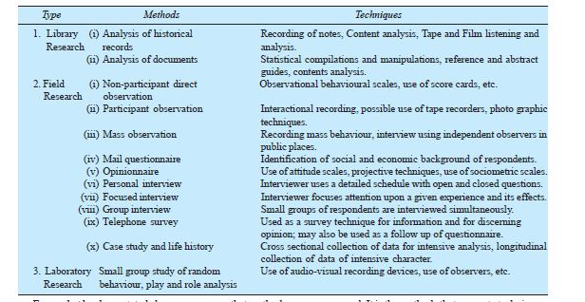

Slide 20
Importance of Knowing How Research is Done
For one who is preparing himself for a career of carrying out research, the importance of knowing research methodology and research techniques is obvious since the same constitute the tools of his trade.
The knowledge of methodology provides good training specially to the new research worker and enables him to do better research.
It helps him to develop disciplined thinking or a ‘bent of mind’ to observe the field objectively.
Hence, those aspiring for careerism in research must develop the skill of using research techniques and must thoroughly understand the logic behind them.

Slide 21
Knowledge of how to do research will inculcate the ability to evaluate and use research results with reasonable confidence.
In other words, we can state that the knowledge of research methodology is helpful in various fields such as government or business administration, community development and social work where persons are increasingly called upon to evaluate and use research results for action.

Slide 22
In this scientific age, all of us are in many ways consumers of research results and we can use them intelligently provided we are able to judge the adequacy of the methods by which
they have been obtained.
The knowledge of methodology helps the consumer of research results to evaluate them and enables him to take rational decisions.

Slide 23
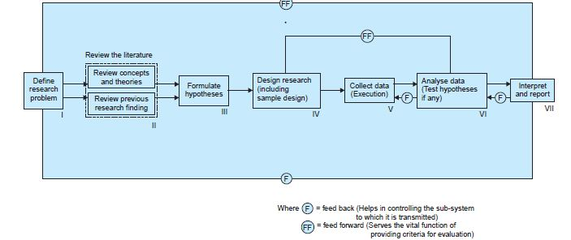
Research Process

Slide 24
Criteria of Good Research
Purpose of the research should be clearly defined and common concepts be used.
The procedural design of the research should be carefully planned to yield results that are as objective as possible.
The researcher should report with complete frankness, flaws in procedural design and estimate their effects upon the findings.
The analysis of data should be sufficiently adequate to reveal its significance and the methods of analysis used should be appropriate. The validity and reliability of the data should be checked carefully.
Conclusions should be confined to those justified by the data of the research and limited to those for which the data provide an adequate basis.
Greater confidence in research is warranted if the researcher is experienced, has a good reputation in research and is a person of integrity.

Slide 25
Qualities of a Good Research
Good research is systematic: It means that research is structured with specified steps to be taken in a specified sequence in accordance with the well defined set of rules.
Good research is logical: This implies that research is guided by the rules of logical reasoning and the logical process of induction and deduction are of great value in carrying out research. In fact, logical reasoning makes research more meaningful in the context of decision making.
Good research is empirical
Good research is replicable

Slide 26
Problems Encountered by Researchers in India
The lack of a scientific training in the methodology of research.
There is insufficient interaction between the university research departments on one side and business establishments, government departments and research institutions on the other side.
Most of the business units in our country do not have the confidence that the material supplied by them to researchers will not be misused and as such they are often reluctant in supplying the needed information to researchers.

Slide 27
There does not exist a code of conduct for researchers and inter-university and interdepartmental rivalries are also quite common.
Many researchers in our country also face the difficulty of adequate and timely secretarial assistance, including computerial assistance.
Library management and functioning is not satisfactory at many places and much of the time and energy of researchers are spent in tracing out the books, journals, reports, etc., rather than in tracing out relevant material from them.
There is also the difficulty of timely availability of published data from various government and other agencies doing this job in our country.

